Slide 1
Chapter 3 – Describing Logic Circuits

Slide 2
Chapter 3 Objectives
Selected areas covered in this chapter:
  Operation of truth tables for AND, NAND, OR, and NOR gates, and the NOT (INVERTER) circuit.
  Boolean expression for logic gates.
  DeMorgan’s theorems to simplify logic expressions.
  Universal gates (NAND or NOR) to implement a circuit represented by a Boolean expression.
  Concepts of active-LOW & active-HIGH logic signals.
  Describing and measuring propagation delay time.
  Differences between an HDL and a computer programming language.
Digital Systems: Principles and Applications, 11/e
Ronald J. Tocci, Neal S. Widmer, Gregory L. Moss

Slide 3
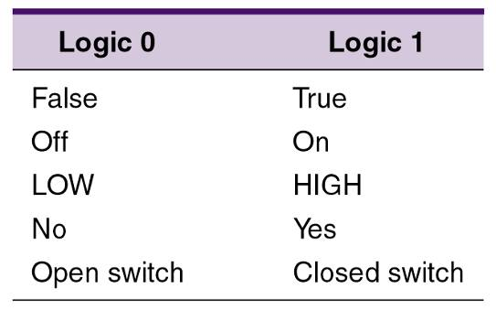
3-1 Boolean Constants and Variables
Boolean algebra allows only two values—0 and 1.
  Logic 0 can be: false, off, low, no, open switch.
  Logic 1 can be: true, on, high, yes, closed switch.
The three basic logic operations:
  OR, AND, and NOT.
Digital Systems: Principles and Applications, 11/e
Ronald J. Tocci, Neal S. Widmer, Gregory L. Moss

Slide 4
3-2 Truth Tables
A truth table describes the relationship between the input and output of a logic circuit.
The number of entries corresponds to the number of inputs.
  A 2-input table would have 2² = 4 entries.
  A 3-input table would have 2³ = 8 entries.
Digital Systems: Principles and Applications, 11/e
Ronald J. Tocci, Neal S. Widmer, Gregory L. Moss

Slide 5
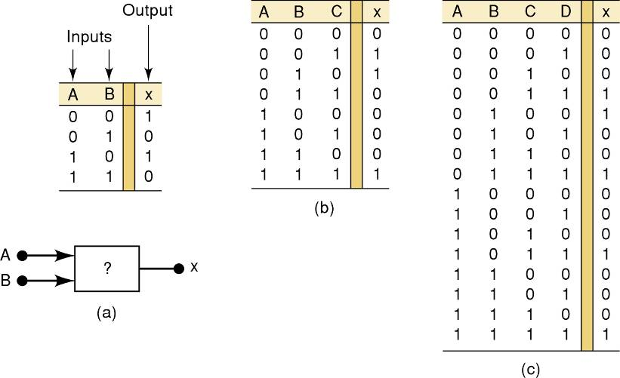
3-2 Truth Tables
Examples of truth tables with 2, 3, and 4 inputs.
Digital Systems: Principles and Applications, 11/e
Ronald J. Tocci, Neal S. Widmer, Gregory L. Moss

Slide 6
3-3 OR Operation With OR Gates
The Boolean expression for the OR operation is:
    X = A + B — Read as “X equals A OR B”
The + sign does not stand for ordinary
addition—it stands for the OR operation
The OR operation is similar to addition, but when A = 1 and B = 1, the OR operation produces:
1 + 1 = 1 not 1 + 1 = 2
In the Boolean expression x = 1 + 1 + 1 = 1…
    x is true (1) when A is true (1) OR B is true (1) OR C is true (1)
Digital Systems: Principles and Applications, 11/e
Ronald J. Tocci, Neal S. Widmer, Gregory L. Moss

Slide 7
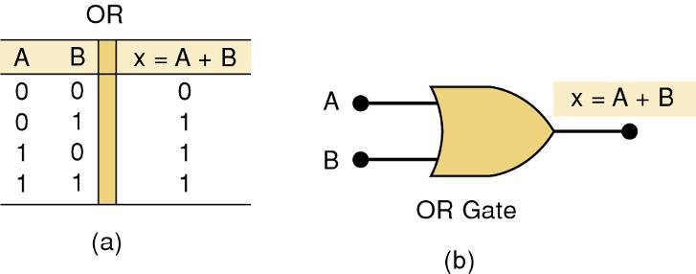
3-3 OR Operation With OR Gates
An OR gate is a circuit with two or more inputs, whose output is equal to the OR combination
of the inputs.
Truth table/circuit symbol for a two input OR gate.
Digital Systems: Principles and Applications, 11/e
Ronald J. Tocci, Neal S. Widmer, Gregory L. Moss

Slide 8
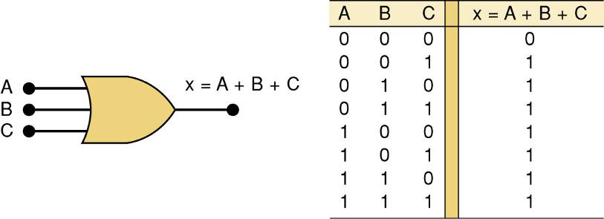
3-3 OR Operation With OR Gates
An OR gate is a circuit with two or more inputs, whose output is equal to the OR combination
of the inputs.
Truth table/circuit symbol for a three input OR gate.
Digital Systems: Principles and Applications, 11/e
Ronald J. Tocci, Neal S. Widmer, Gregory L. Moss

Slide 9
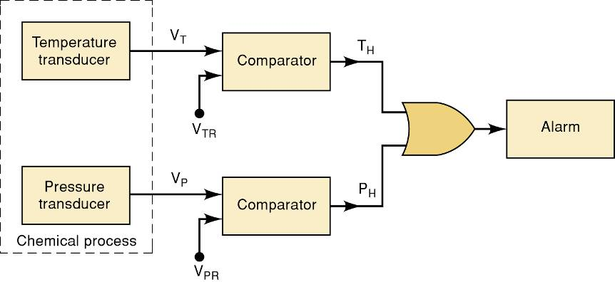
3-3 OR Operation With OR Gates
Example of the use of an OR
gate in an alarm system.
Digital Systems: Principles and Applications, 11/e
Ronald J. Tocci, Neal S. Widmer, Gregory L. Moss

Slide 10
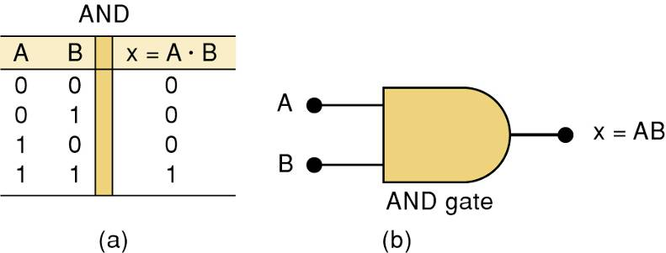
3-4 AND Operations with AND gates
The AND operation is similar to multiplication:
X = A • B • C — Read as “X equals A AND B AND C”
The + sign does not stand for ordinary
multiplication—it stands for the AND operation.
    x is true (1) when A AND B AND C are true (1)
Truth table — Gate symbol.
Digital Systems: Principles and Applications, 11/e
Ronald J. Tocci, Neal S. Widmer, Gregory L. Moss

Slide 11
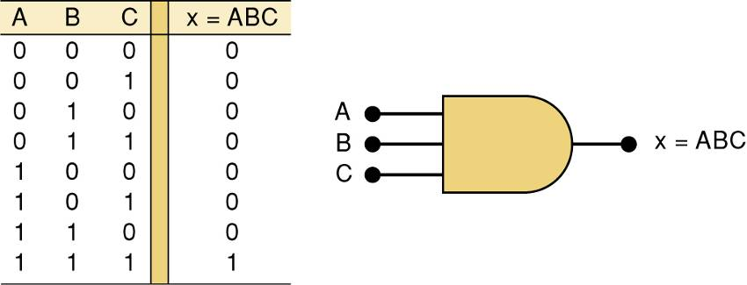
3-4 AND Operations with AND gates
Truth table/circuit symbol for a three input AND gate.
Digital Systems: Principles and Applications, 11/e
Ronald J. Tocci, Neal S. Widmer, Gregory L. Moss

Slide 12
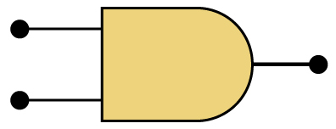
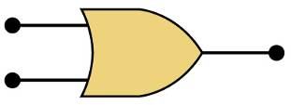
AND / OR
The AND symbol on a logic-circuit diagram tells you output will go HIGH only
when all inputs are HIGH.
The OR symbol means the output will go HIGH when
any input is HIGH.
Digital Systems: Principles and Applications, 11/e
Ronald J. Tocci, Neal S. Widmer, Gregory L. Moss

Slide 13
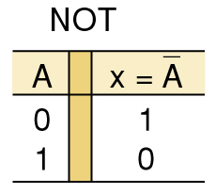
3-5 NOT Operation
The Boolean expression for the NOT operation:
X = A
— Read as:
“X equals NOT A”
“X equals the inverse of A”
“X equals the complement of A”
The overbar represents
the NOT operation.
A' = A
Another indicator for inversion is the
prime symbol (').
    NOT Truth Table
Digital Systems: Principles and Applications, 11/e
Ronald J. Tocci, Neal S. Widmer, Gregory L. Moss

Slide 14
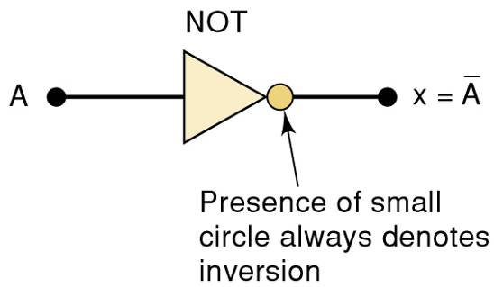
3-5 NOT Operation
A NOT circuit—commonly called an INVERTER.
This circuit always has only a single input, and the out-put
logic level is always opposite to the logic level of this input.
Digital Systems: Principles and Applications, 11/e
Ronald J. Tocci, Neal S. Widmer, Gregory L. Moss

Slide 15
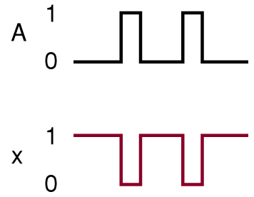
3-5 NOT Operation
The INVERTER inverts (complements) the
input signal at all points on the waveform.
Whenever the input = 0, output = 1, and vice versa.
Digital Systems: Principles and Applications, 11/e
Ronald J. Tocci, Neal S. Widmer, Gregory L. Moss

Slide 16
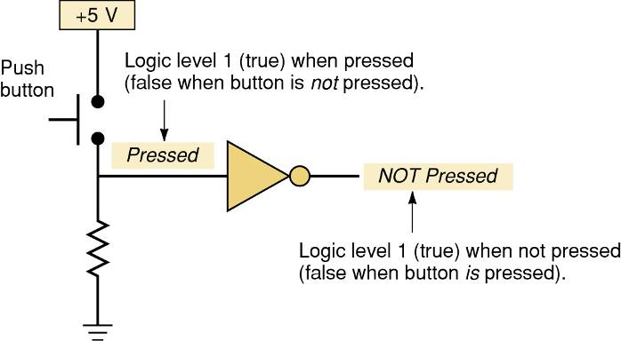
3-5 NOT Operation
Typical application of the NOT gate.
This circuit provides an expression that
is true when the button is not pressed.
Digital Systems: Principles and Applications, 11/e
Ronald J. Tocci, Neal S. Widmer, Gregory L. Moss

Slide 17
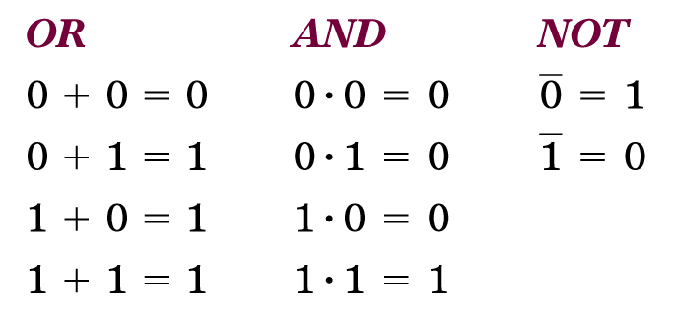
Boolean Operations
Summarized rules for OR, AND and NOT
These three basic Boolean operations
can describe any logic circuit.
Digital Systems: Principles and Applications, 11/e
Ronald J. Tocci, Neal S. Widmer, Gregory L. Moss

Slide 18
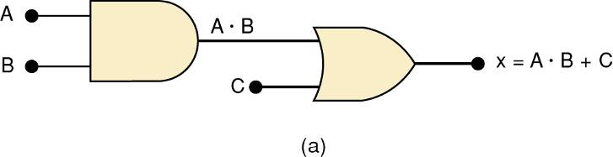
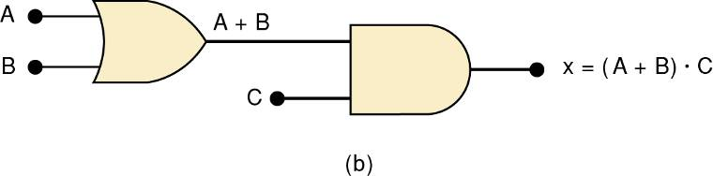
3-6 Describing Logic Circuits Algebraically
If an expression contains both AND and OR gates, the AND operation will be performed first.
Unless there is a parenthesis in the expression.
Digital Systems: Principles and Applications, 11/e
Ronald J. Tocci, Neal S. Widmer, Gregory L. Moss

Slide 19
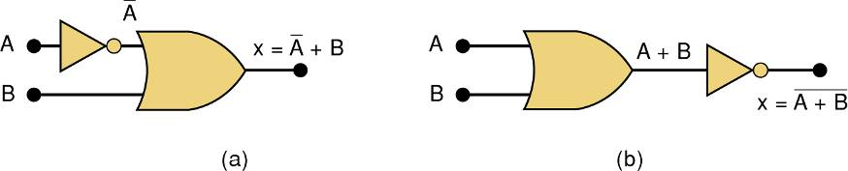
3-6 Describing Logic Circuits Algebraically
Whenever an INVERTER is present, output is equivalent to input, with a bar over it.
  Input A through an inverter equals A.
Digital Systems: Principles and Applications, 11/e
Ronald J. Tocci, Neal S. Widmer, Gregory L. Moss

Slide 20
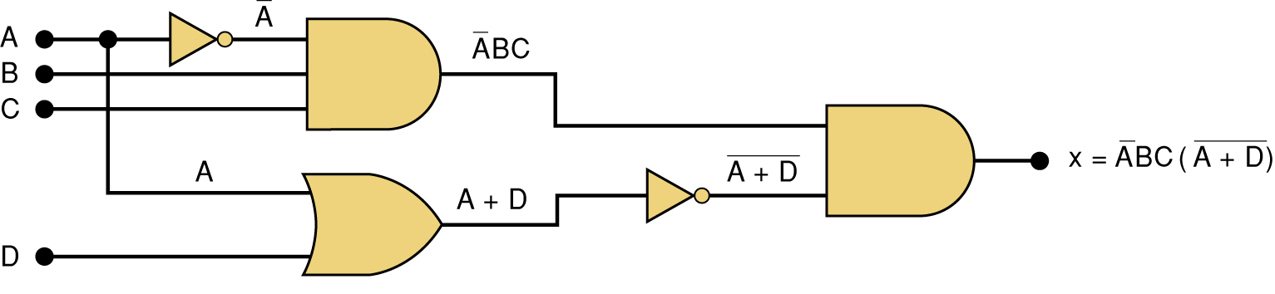
3-6 Describing Logic Circuits Algebraically
Further examples…
Digital Systems: Principles and Applications, 11/e
Ronald J. Tocci, Neal S. Widmer, Gregory L. Moss

Slide 21
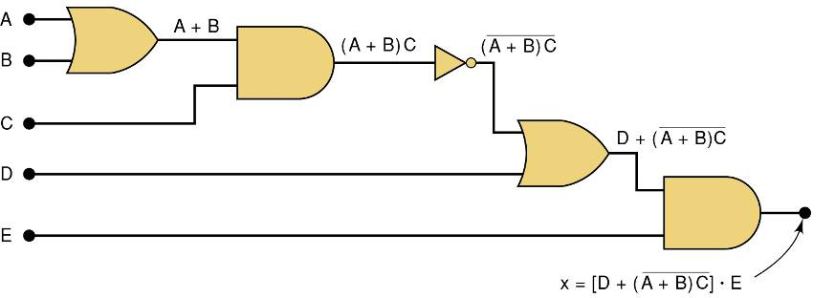
3-6 Describing Logic Circuits Algebraically
Further examples…
Digital Systems: Principles and Applications, 11/e
Ronald J. Tocci, Neal S. Widmer, Gregory L. Moss

Slide 22
3-7 Evaluating Logic Circuit Outputs
Rules for evaluating a Boolean expression:
  Perform all inversions of single terms.
  Perform all operations within parenthesis.
  Perform AND operation before an OR operation unless parenthesis indicate otherwise.
  If an expression has a bar over it, perform operations inside the expression, and then invert the result.
Digital Systems: Principles and Applications, 11/e
Ronald J. Tocci, Neal S. Widmer, Gregory L. Moss

Slide 23
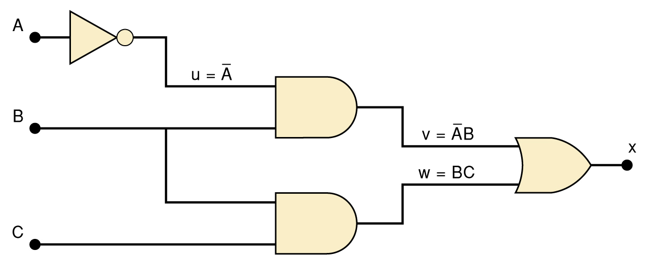
3-7 Evaluating Logic Circuit Outputs
The best way to analyze a circuit made up of multiple logic gates is to use a truth table.
  It allows you to analyze one gate or logic
  combination at a time.
  It allows you to easily double-check your work.
  When you are done, you have a table of tremendous benefit in troubleshooting the logic circuit.
Digital Systems: Principles and Applications, 11/e
Ronald J. Tocci, Neal S. Widmer, Gregory L. Moss

Slide 24
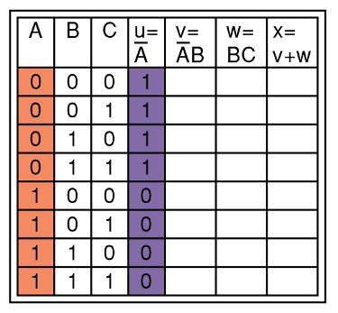

3-7 Evaluating Logic Circuit Outputs
The first step after listing all input combinations
is to create a column in the truth table for each intermediate signal (node).
Node u has been filled as the complement of A
Digital Systems: Principles and Applications, 11/e
Ronald J. Tocci, Neal S. Widmer, Gregory L. Moss

Slide 25
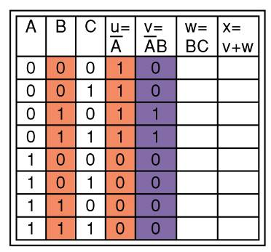
3-7 Evaluating Logic Circuit Outputs
The next step is to fill in the values for column v.
v =AB — Node v should be HIGH
when A (node u) is HIGH AND B is HIGH
Digital Systems: Principles and Applications, 11/e
Ronald J. Tocci, Neal S. Widmer, Gregory L. Moss

Slide 26
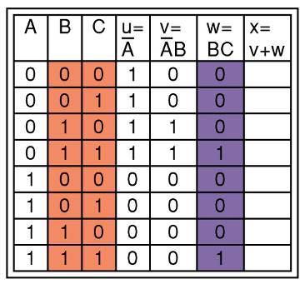
3-7 Evaluating Logic Circuit Outputs
The third step is to predict the values at node w which is the logical product of BC.
This column is HIGH whenever B is HIGH AND C is HIGH
Digital Systems: Principles and Applications, 11/e
Ronald J. Tocci, Neal S. Widmer, Gregory L. Moss

Slide 27
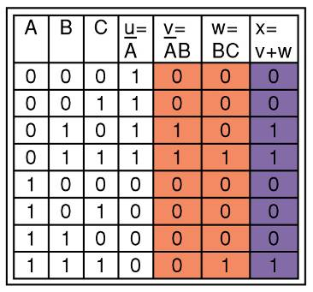
3-7 Evaluating Logic Circuit Outputs
The final step is to logically combine columns v and w to predict the output x.
Since x = v + w, the x output will be HIGH when v OR w is HIGH
Digital Systems: Principles and Applications, 11/e
Ronald J. Tocci, Neal S. Widmer, Gregory L. Moss

Slide 28
3-7 Evaluating Logic Circuit Outputs
Output logic levels can be determined directly from a circuit diagram.
  Output of each gate is noted until final output is found.
    Technicians frequently use this method.
Digital Systems: Principles and Applications, 11/e
Ronald J. Tocci, Neal S. Widmer, Gregory L. Moss

Slide 29
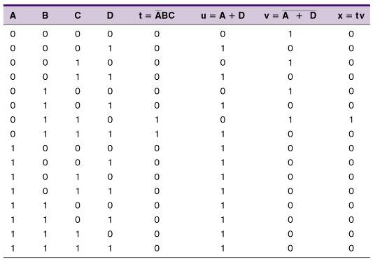
3-7 Evaluating Logic Circuit Outputs
Table of logic state
at each node of the
circuit shown.
Digital Systems: Principles and Applications, 11/e
Ronald J. Tocci, Neal S. Widmer, Gregory L. Moss

Slide 30
3-8 Implementing Circuits From Boolean Expressions
It is important to be able to draw a logic circuit from a Boolean expression.
  The expression X = A • B • C, could be drawn
  as a three input AND gate.
  A circuit defined by X = A + B, would use a two-input OR gate with an INVERTER on one of
  the inputs.
Digital Systems: Principles and Applications, 11/e
Ronald J. Tocci, Neal S. Widmer, Gregory L. Moss

Slide 31
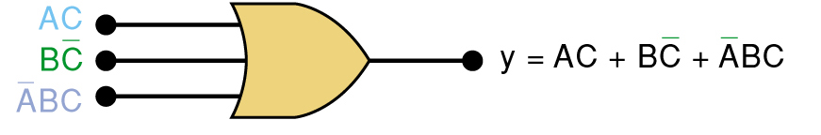
3-8 Implementing Circuits From Boolean Expressions
A circuit with output y = AC + BC + ABC
contains three terms which are ORed together.
…and requires a three-input OR gate.
Digital Systems: Principles and Applications, 11/e
Ronald J. Tocci, Neal S. Widmer, Gregory L. Moss

Slide 32
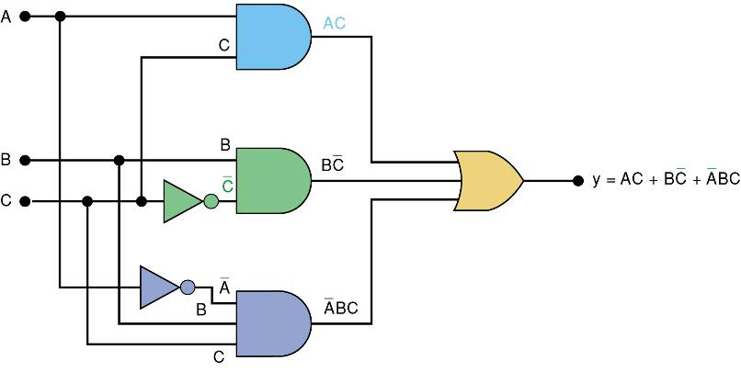
3-8 Implementing Circuits From Boolean Expressions
Each OR gate input is an AND product term,
  An AND gate with appropriate inputs can be
  used to generate each of these terms.
Digital Systems: Principles and Applications, 11/e
Ronald J. Tocci, Neal S. Widmer, Gregory L. Moss

Slide 33
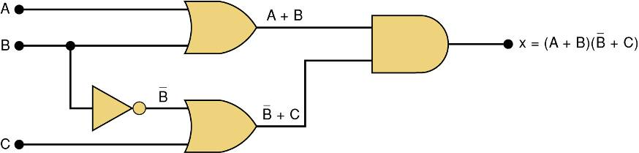
3-8 Implementing Circuits From Boolean Expressions
Circuit diagram to implement x = (A + B) (B + C)
Digital Systems: Principles and Applications, 11/e
Ronald J. Tocci, Neal S. Widmer, Gregory L. Moss

Slide 34
3-9 NOR Gates and NAND Gates
Combine basic AND, OR, and NOT operations.
  Simplifying the writing of Boolean expressions
Output of NAND and NOR gates may be found
by determining the output of an AND or OR
gate, and inverting it.
  The truth tables for NOR and NAND gates show the complement of truth tables for OR and AND gates.
Digital Systems: Principles and Applications, 11/e
Ronald J. Tocci, Neal S. Widmer, Gregory L. Moss

Slide 35
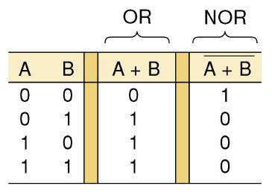
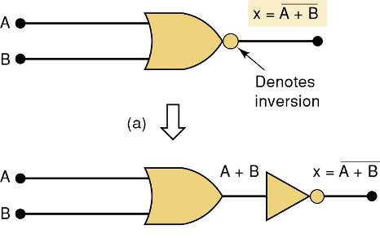
3-9 NOR Gates and NAND Gates
The NOR gate is an inverted OR gate.
  An inversion “bubble” is placed at the output
  of the OR gate, making the Boolean output expression x = A + B
Digital Systems: Principles and Applications, 11/e
Ronald J. Tocci, Neal S. Widmer, Gregory L. Moss

Slide 36
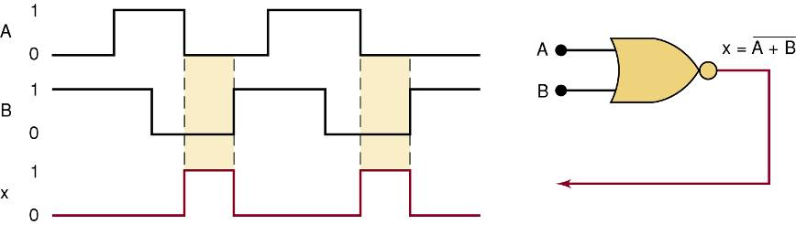
3-9 NOR Gates and NAND Gates
Output waveform of a NOR gate for
the input waveforms shown here.
Digital Systems: Principles and Applications, 11/e
Ronald J. Tocci, Neal S. Widmer, Gregory L. Moss

Slide 37
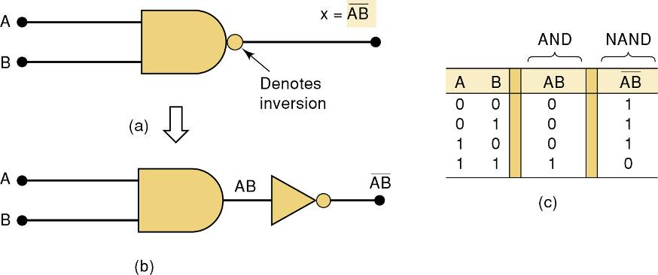
3-9 NOR Gates and NAND Gates
The NAND gate is an inverted AND gate.
  An inversion “bubble” is placed at the output
  of the AND gate, making the Boolean output
  expression x = AB
Digital Systems: Principles and Applications, 11/e
Ronald J. Tocci, Neal S. Widmer, Gregory L. Moss

Slide 38
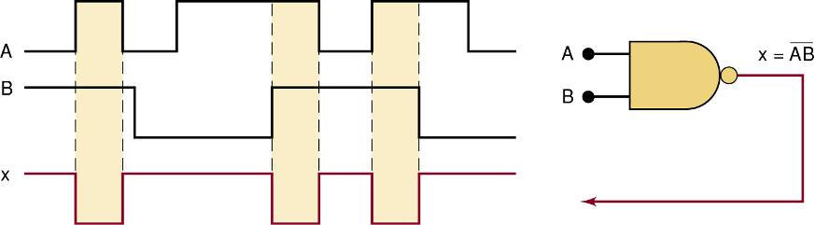
3-9 NOR Gates and NAND Gates
Output waveform of a NAND gate for
the input waveforms shown here.
Digital Systems: Principles and Applications, 11/e
Ronald J. Tocci, Neal S. Widmer, Gregory L. Moss

Slide 39
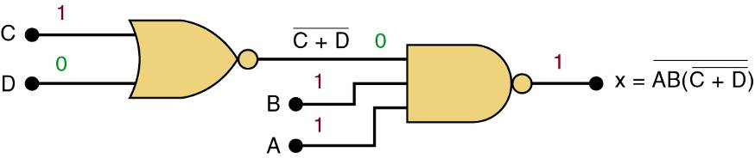
3-9 NOR Gates and NAND Gates
Logic circuit with the expression x = AB • (C + D)
using only NOR and NAND gates.
Digital Systems: Principles and Applications, 11/e
Ronald J. Tocci, Neal S. Widmer, Gregory L. Moss

Slide 40
3-10 Boolean Theorems
The theorems or laws that follow may represent an expression containing more than one variable.
Digital Systems: Principles and Applications, 11/e
Ronald J. Tocci, Neal S. Widmer, Gregory L. Moss

Slide 41
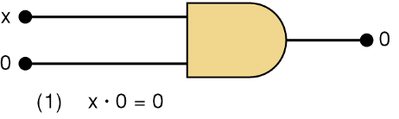
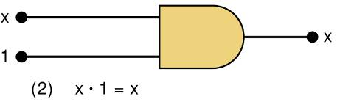
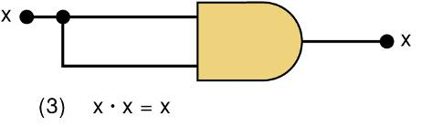
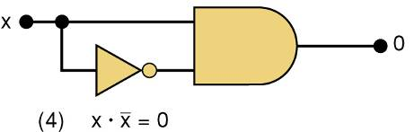
3-10 Boolean Theorems
Theorem (1) states that if any variable
is ANDed with 0, the result must be 0.
Theorem (2) is also obvious
by comparison with ordinary
multiplication.
Prove Theorem (3) by trying each case.
If x = 0, then 0 • 0 = 0
If x = 1, then 1 • 1 = 1
Thus, x • x = x
Theorem (4) can be proved
in the same manner.
Digital Systems: Principles and Applications, 11/e
Ronald J. Tocci, Neal S. Widmer, Gregory L. Moss

Slide 42
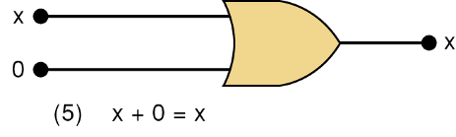
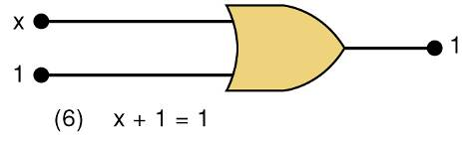
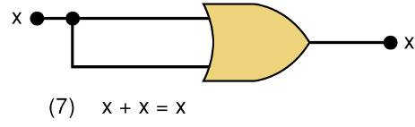
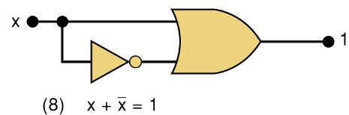
3-10 Boolean Theorems
Theorem (5) is straightforward,
as 0 added to anything does not affect value, either in regular addition or in OR addition.
Theorem (6) states that if any variable
is ORed with 1, the is always 1.
Check values: 0 + 1 = 1 and 1 + 1 = 1.
Theorem (7) can be proved by
checking for both values of x:
0 + 0 = 0 and 1 + 1 = 1.
Theorem (8) can be proved similarly.
Digital Systems: Principles and Applications, 11/e
Ronald J. Tocci, Neal S. Widmer, Gregory L. Moss

Slide 43
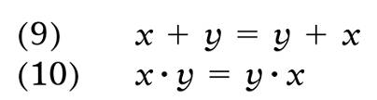


3-10 Boolean Theorems
Multivariable Theorems
Commutative laws
Associative laws
Distributive law
Digital Systems: Principles and Applications, 11/e
Ronald J. Tocci, Neal S. Widmer, Gregory L. Moss

Slide 44
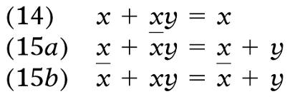
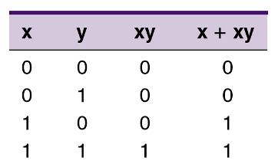

3-10 Boolean Theorems
Multivariable Theorems
Theorems (14) and (15) do not have counterparts
in ordinary algebra. Each can be proved by
trying all possible cases for x and y.
Analysis table & factoring
for Theorem (14)
Digital Systems: Principles and Applications, 11/e
Ronald J. Tocci, Neal S. Widmer, Gregory L. Moss

Slide 45
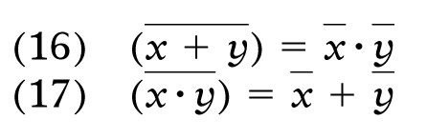
3-11 DeMorgan’s Theorems
DeMorgan’s theorems are extremely useful in simplifying expressions in which a product or
sum of variables is inverted.
Theorem (16) says inverting the OR sum of two variables is the same as inverting each variable individually, then ANDing the inverted variables.
Theorem (17) says inverting the AND product of two variables is the
same as inverting each variable individually and then ORing them.
Each of DeMorgan’s theorems can readily be proven by checking for all possible combinations of x and y.
Digital Systems: Principles and Applications, 11/e
Ronald J. Tocci, Neal S. Widmer, Gregory L. Moss

Slide 46
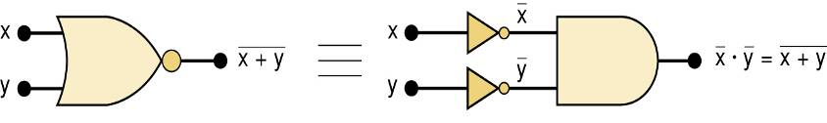
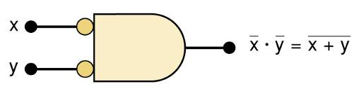
3-11 DeMorgan’s Theorems
Equivalent circuits implied by Theorem (16)
The alternative symbol
for the NOR function.
Digital Systems: Principles and Applications, 11/e
Ronald J. Tocci, Neal S. Widmer, Gregory L. Moss

Slide 47
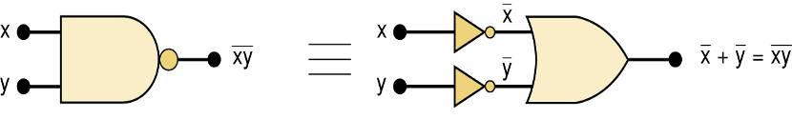
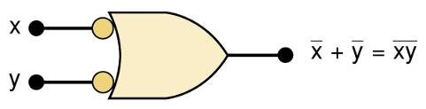
3-11 DeMorgan’s Theorems
Equivalent circuits implied by Theorem (17)
The alternative symbol
for the NAND function.
Digital Systems: Principles and Applications, 11/e
Ronald J. Tocci, Neal S. Widmer, Gregory L. Moss

Slide 48
3-12 Universality of NAND and NOR Gates
NAND or NOR gates can be used to create the three basic logic expressions.
  OR, AND, and INVERT.
    Provides flexibility—very useful in logic circuit design.
Digital Systems: Principles and Applications, 11/e
Ronald J. Tocci, Neal S. Widmer, Gregory L. Moss

Slide 49

3-12 Universality of NAND and NOR Gates
How combinations of NANDs or NORs are
used to create the three logic functions.
It is possible, however, to implement any logic expression using only NAND gates and no other type of gate, as shown.
Digital Systems: Principles and Applications, 11/e
Ronald J. Tocci, Neal S. Widmer, Gregory L. Moss

Slide 50

3-12 Universality of NAND and NOR Gates
How combinations of NANDs or NORs are
used to create the three logic functions.
NOR gates can be arranged to implement
any of the Boolean operations, as shown.
Digital Systems: Principles and Applications, 11/e
Ronald J. Tocci, Neal S. Widmer, Gregory L. Moss

Slide 51

3-12 Universality of NAND and NOR Gates
A logic circuit to generate a signal x, that will go HIGH whenever conditions A and B exist simultaneously, or whenever conditions C and D exist simultaneously.
The logic expression will be x = AB + CD.
Each of the TTL ICs shown here will fulfill the function. Each IC is a quad, with four identical gates on one chip
Digital Systems: Principles and Applications, 11/e
Ronald J. Tocci, Neal S. Widmer, Gregory L. Moss

Slide 52



3-12 Universality of NAND and NOR Gates
Possible Implementations # 1
Digital Systems: Principles and Applications, 11/e
Ronald J. Tocci, Neal S. Widmer, Gregory L. Moss

Slide 53


3-12 Universality of NAND and NOR Gates
Possible Implementations #2
Digital Systems: Principles and Applications, 11/e
Ronald J. Tocci, Neal S. Widmer, Gregory L. Moss

Slide 54

3-13 Alternate Logic-Gate Representations
To convert a standard symbol to an alternate:
  Invert each input and output in standard symbols.
    Add an inversion bubble where there are none.
    Remove bubbles where they exist.
Digital Systems: Principles and Applications, 11/e
Ronald J. Tocci, Neal S. Widmer, Gregory L. Moss

Slide 55
3-13 Alternate Logic-Gate Representations
Points regarding logic symbol equivalences:
  The equivalences can be extended to gates with
  any number of inputs.
  None of the standard symbols have bubbles on
  their inputs, and all the alternate symbols do.
  Standard & alternate symbols for each gate represent the same physical circuit.
  NAND and NOR gates are inverting gates.
    Both the standard and the alternate symbols for each will have a bubble on either the input or the output.
  AND and OR gates are noninverting gates.
    The alternate symbols for each will have bubbles
    on both inputs and output.
Digital Systems: Principles and Applications, 11/e
Ronald J. Tocci, Neal S. Widmer, Gregory L. Moss

Slide 56
3-13 Alternate Logic-Gate Representations
Active-HIGH – an input/output has no inversion bubble.
Active-LOW – an input or output has an inversion bubble.
Digital Systems: Principles and Applications, 11/e
Ronald J. Tocci, Neal S. Widmer, Gregory L. Moss

Slide 57

3-13 Alternate Logic-Gate Representations
Interpretation of the two NAND gate symbols.
Digital Systems: Principles and Applications, 11/e
Ronald J. Tocci, Neal S. Widmer, Gregory L. Moss

Slide 58

3-13 Alternate Logic-Gate Representations
Interpretation of the two OR gate symbols.
Digital Systems: Principles and Applications, 11/e
Ronald J. Tocci, Neal S. Widmer, Gregory L. Moss

Slide 59




3-14 Which Gate Representation to Use
Proper use of alternate gate symbols in the circuit diagram can make circuit operation much clearer.
Original circuit using standard NAND symbols.
Equivalent representation
where output Z is
active-HIGH.
Equivalent representation where output Z is
active-LOW.
Digital Systems: Principles and Applications, 11/e
Ronald J. Tocci, Neal S. Widmer, Gregory L. Moss

Slide 60
3-14 Which Gate Representation to Use
When a logic signal is in the active state (HIGH or LOW) it is said to be asserted.
When a logic signal is in the inactive state (HIGH or LOW) it is said to be unasserted.
A bar over a signal means asserted (active) LOW.
Absence of a bar means asserted (active) HIGH
RD
RD
Digital Systems: Principles and Applications, 11/e
Ronald J. Tocci, Neal S. Widmer, Gregory L. Moss

Slide 61
3-14 Which Gate Representation to Use
An output signal can have two active states,
with an important function in the HIGH state,
and another in the LOW state.
  It is customary to label such signals so both
  active states are apparent.
A common example is the read/write signal.
RD/WR
When this signal is HIGH, the read operation (RD) is performed;
when it is LOW, the write operation (WR) is performed.
Digital Systems: Principles and Applications, 11/e
Ronald J. Tocci, Neal S. Widmer, Gregory L. Moss

Slide 62
3-14 Which Gate Representation to Use
When possible, choose gate symbols so bubble outputs are connected to bubble input.
  Nonbubble outputs connected to nonbubble inputs.
Digital Systems: Principles and Applications, 11/e
Ronald J. Tocci, Neal S. Widmer, Gregory L. Moss

Slide 63

3-14 Which Gate Representation to Use
The logic circuit shown activates an
alarm when output Z goes HIGH.
Modify the circuit diagram
so it represents the circuit
operation more effectively.
The NOR gate symbol should be
changed to the alternate symbol with a nonbubble (active-HIGH) output to match the nonbubble input of AND gate 2.
The circuit now has nonbubble outputs
connected to nonbubble inputs of gate 2.
Digital Systems: Principles and Applications, 11/e
Ronald J. Tocci, Neal S. Widmer, Gregory L. Moss

